Slide 1

LINEAR CONTROL
SYSTEMS
Ali Karimpour
Assistant Professor
Ferdowsi University of Mashhad
Notes:
<<<1.1>>>
###Control System Design###
{{{Control, Design}}}

Slide 2
Lecture 26
Frequency domain charts
Topics to be covered include:
Relative stability measures for minimum phase systems.
  Gain margin.
  Phase margin.
Nichols chart or gain phase plot.
  Stability analysis with gain phase plot.
Bode plot.
  Stability analysis with Bode plot.
Step by step Bode plot construction.

Slide 3
Stability margins
Stability Is Not A Yes/No Proposition
It's not enough to know that a system is stable or unstable. If a system is just barely stable, then a small gain in a system parameter could push the system over the edge, and you will often want to design systems with some margin of error.
If you're going to do that, you'll need some measure of how stable a system is. To get such measures - and there are at least two that are widely used.
Notes:
{{{Gain Margin, Phase Margin}}}

Slide 4




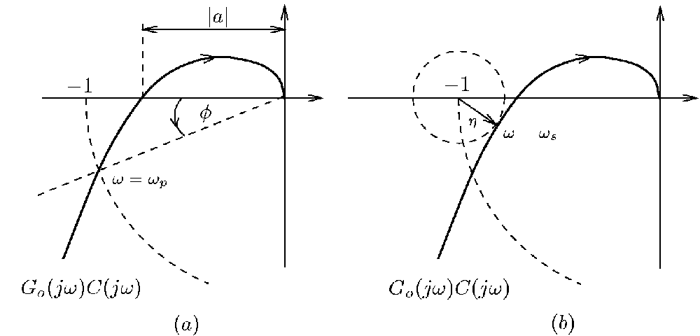

Stability margins
+
Phase Margin
-
Phase margin is the most widely used measure of relative stability when working in the frequency domain.
ω=ω₁₈₀
We define phase margin as the phase (angle) that the frequency response would have to change to move to the -1 point.
ω=ω_{c}
G (jω) G_{c}(jω)
: Is the gain crossover frequency
Notes:
{{{Gain Margin, Phase Margin}}}

Slide 5

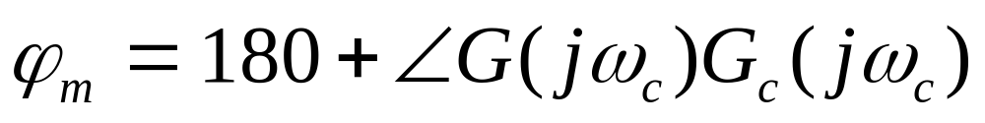

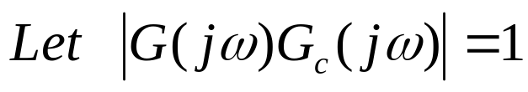

Phase margin computation
+
-
The phase margin, is defined as follows:
ω=ω₁₈₀
ω=ω_{c}
How to derive
G (jω) G_{c}(jω)
Notes:
{{{Gain Margin, Phase Margin}}}

Slide 6
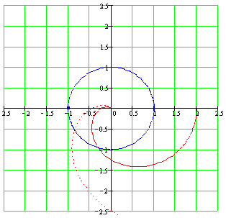
Stability margins
Phase Margin
The two different Nyquist plot above would lead to two different phase margins. The system with the frequency response with the dashed line is less stable.
Notes:
{{{Gain Margin, Phase Margin}}}

Slide 7
Stability margins
Phase Margin
The two different gains shown for the Nyquist plot below would lead to the same phase margins. But do they have the same stability margin?
-1
Clearly no.
Thus we need another measure of relative stability.
Notes:
{{{Gain Margin, Phase Margin}}}

Slide 8

Stability margins
+
Gain Margin
-
Gain margin is another widely used measure of relative stability when working in the frequency domain.
ω=ω₁₈₀
We define gain margin as the gain that the frequency response would have to increase to move to the -1 point.
ω=ω_{c}
G (jω) G_{c}(jω)
: Is the phase crossover frequency
Notes:
{{{Gain Margin, Phase Margin}}}

Slide 9
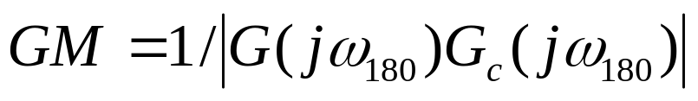
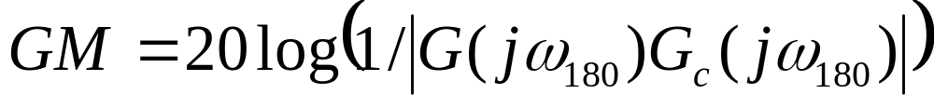




Gain margin computation
+
The gain margin, GM is defined as follows:
-
But gain margin is usually specified in db.
ω=ω₁₈₀
ω=ω_{c}
How to derive
G (jω) G_{c}(jω)
Notes:
{{{Gain Margin, Phase Margin}}}

Slide 10
Stability margins
Phase and Gain Margin
Same Phase Margin
-1
But different Gain Margin
Notes:
{{{Gain Margin, Phase Margin}}}

Slide 11
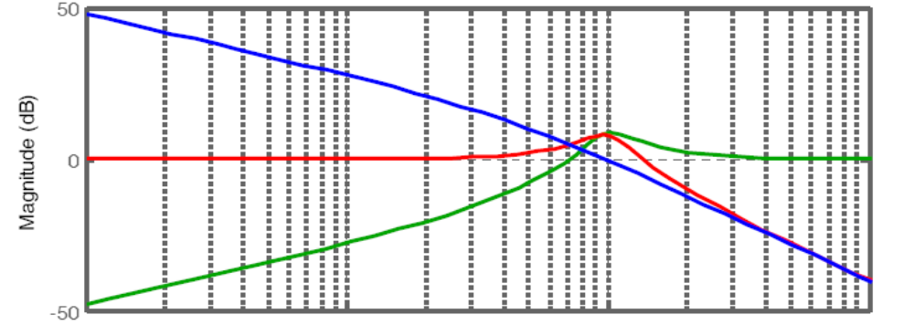





Sensitivity and complementary sensitivity peak
+
-
Frequency (rad/s)
Notes:
{{{Gain Margin, Phase Margin}}}

Slide 12

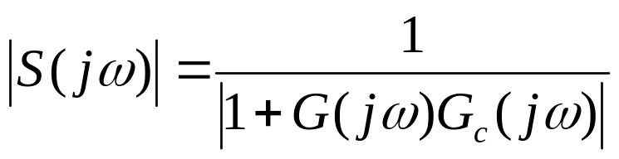



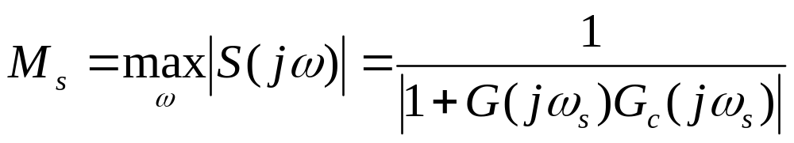
Sensitivity peak
+
-
G (jω) G_{c}(jω)
The sensitivity peak, M_{s} is defined as follows:
Notes:
{{{Gain Margin, Phase Margin}}}

Slide 13
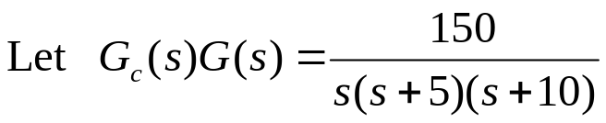
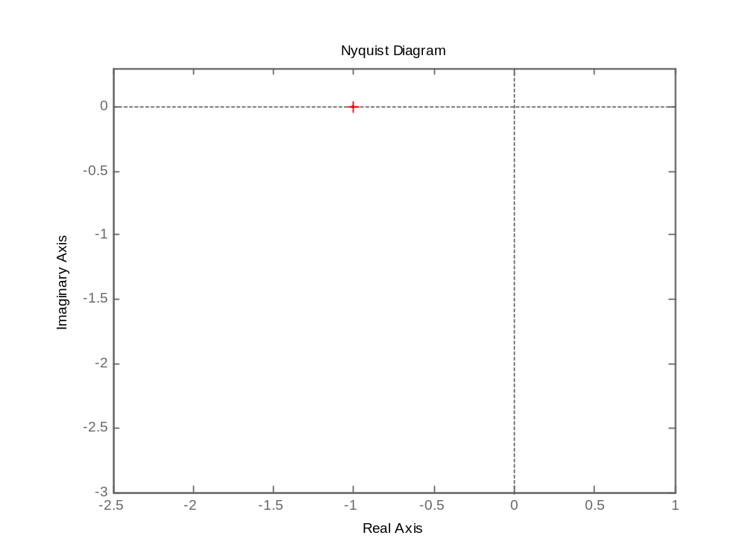

































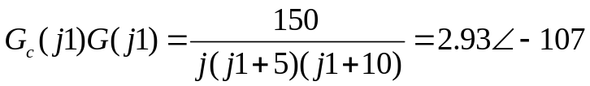



Nyquist chart (polar plot) construction
+
-

Slide 14
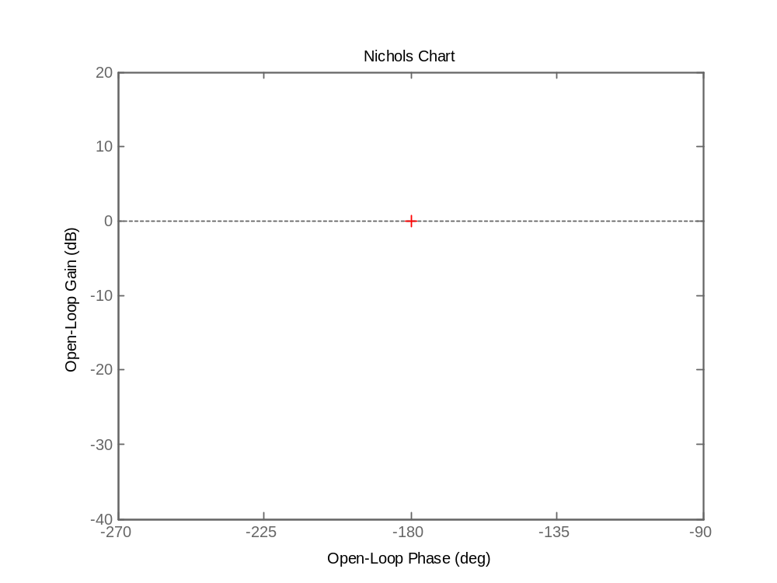
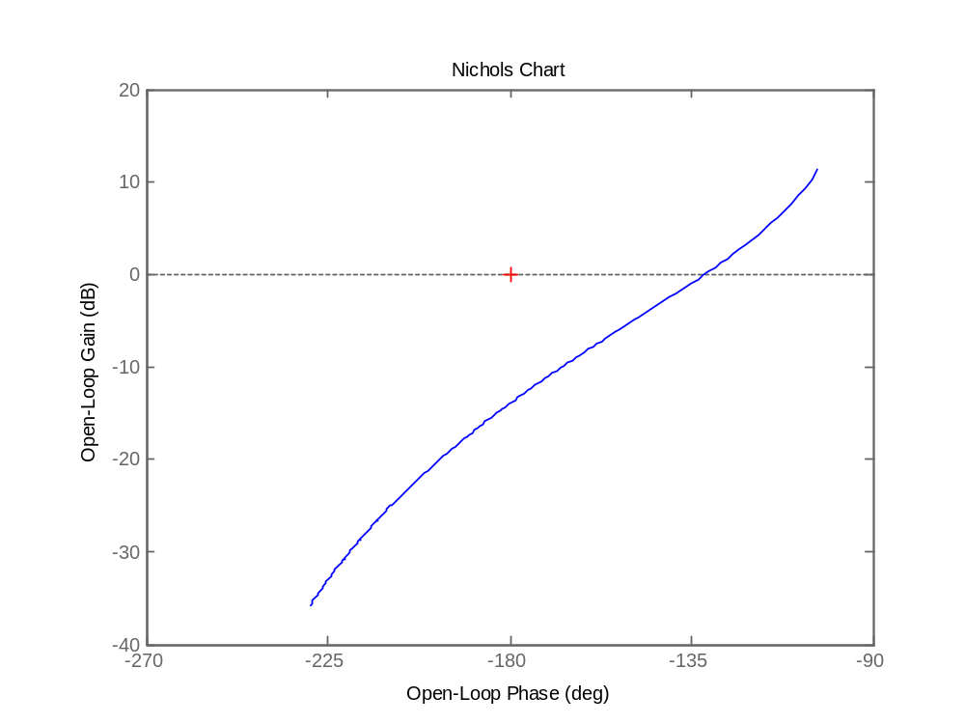














Nichols chart (gain phase plot) construction
+
-

Slide 15
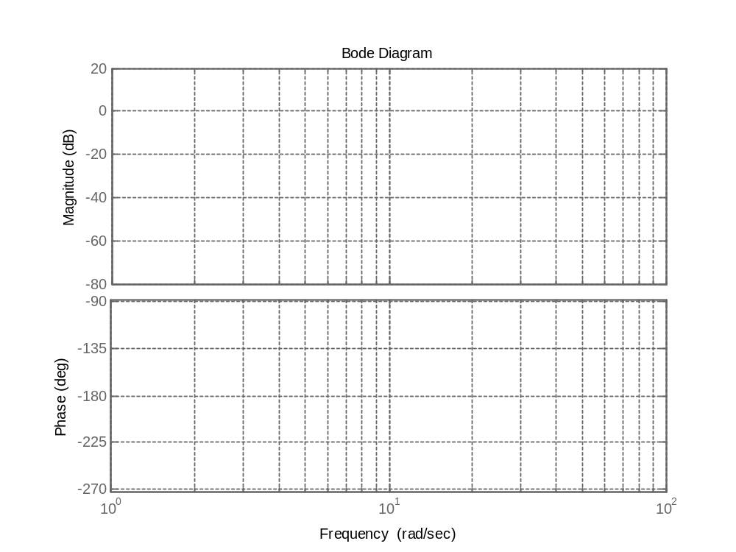
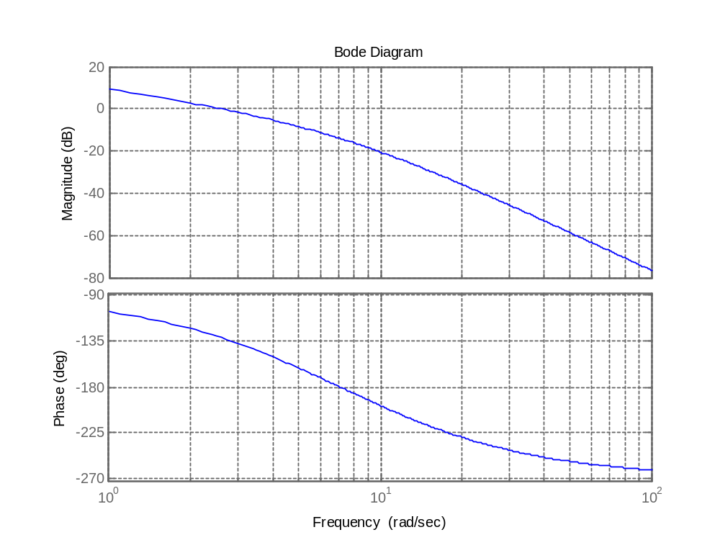


Bode plot construction
+
-

Slide 16
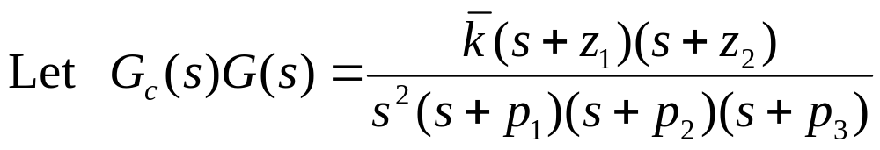
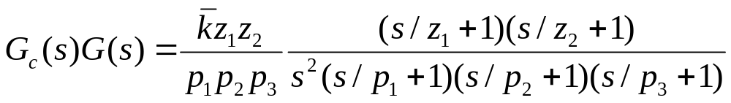
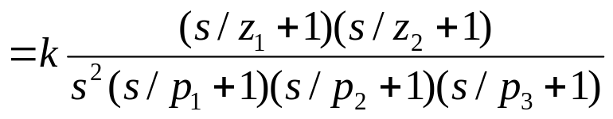
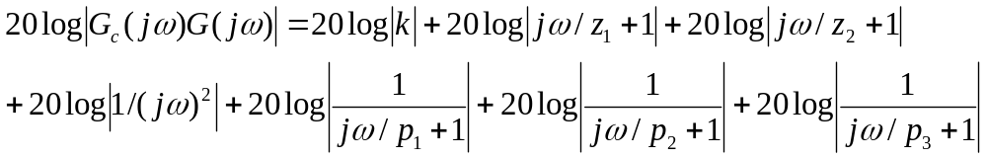
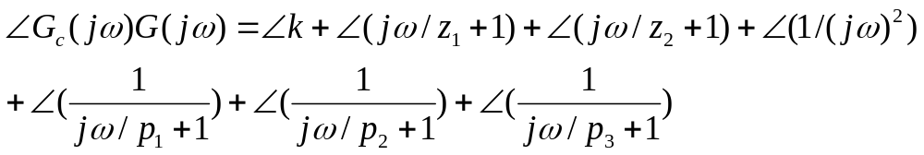
Step by step bode plot construction
Step 1:
Step 2:
Step 3:

Slide 17
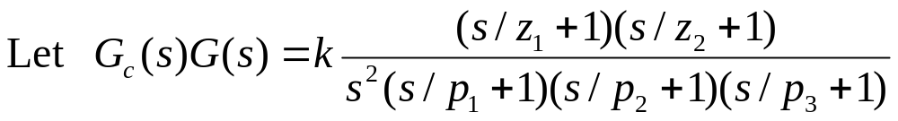
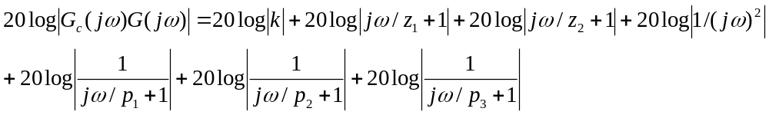
Step by step bode plot construction

Slide 18


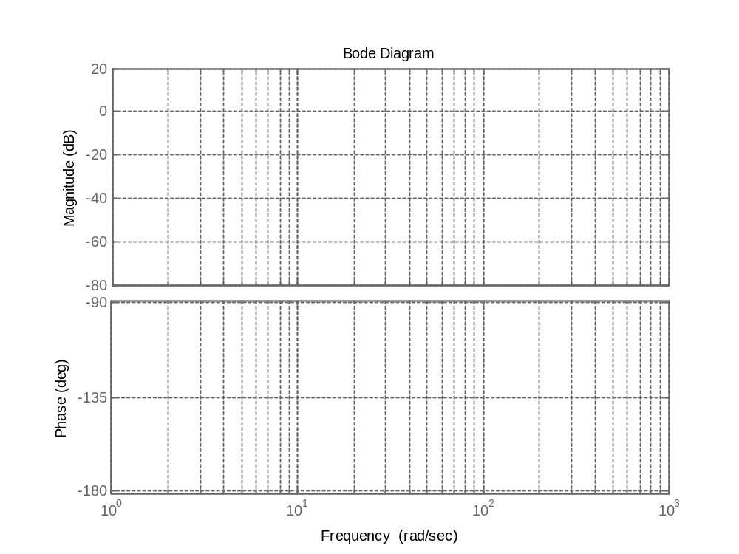


Step by step bode plot construction
Phase (deg) Magnitude (db)
Why 0 or 180?
It depends to sign of k.

Slide 19




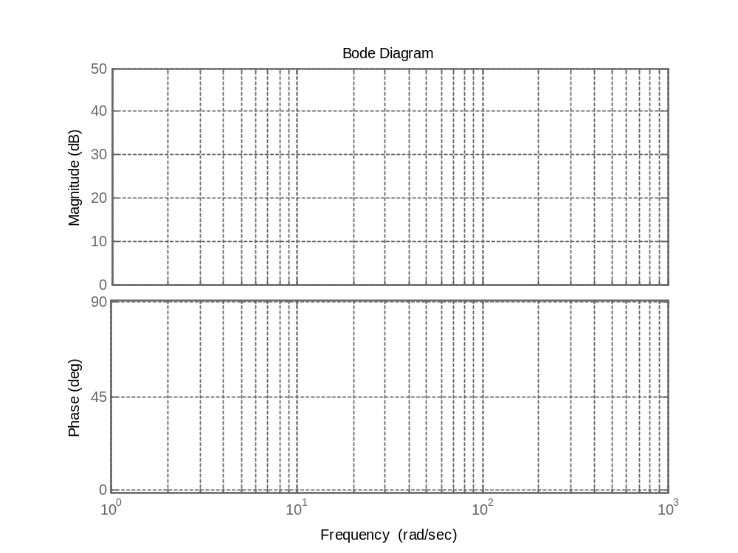







Step by step bode plot construction
20 db / dec
Phase (deg) Magnitude (db)

Slide 20
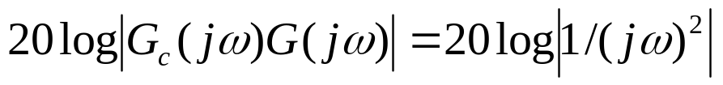








Step by step bode plot construction
-40 db/ dec
Phase (deg) Magnitude (db)

Slide 21
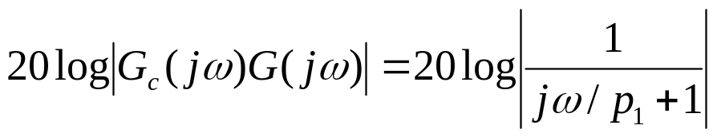
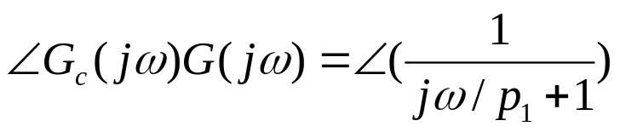







Step by step bode plot construction
-20 db / dec
Phase (deg) Magnitude (db)

Slide 22
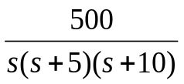
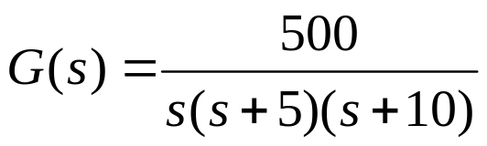
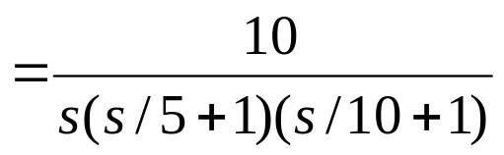
Example 1: Derive the GM and PM of following system by use of Bode plot.
+
-
Open loop transfer function is:
Phase (deg) Magnitude (db)

Slide 23







Example 1: Derive the GM and PM of following system by use of Bode plot.
+
-
Phase (deg) Magnitude (db)

Slide 24
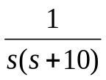

Exercises
1: Derive the gain crossover frequency, gain crossover frequency ,
GM and PM of following system by use of Bode plot.
+
-
Notes:
<<<3.6>>>
###State Space Models###

Slide 25
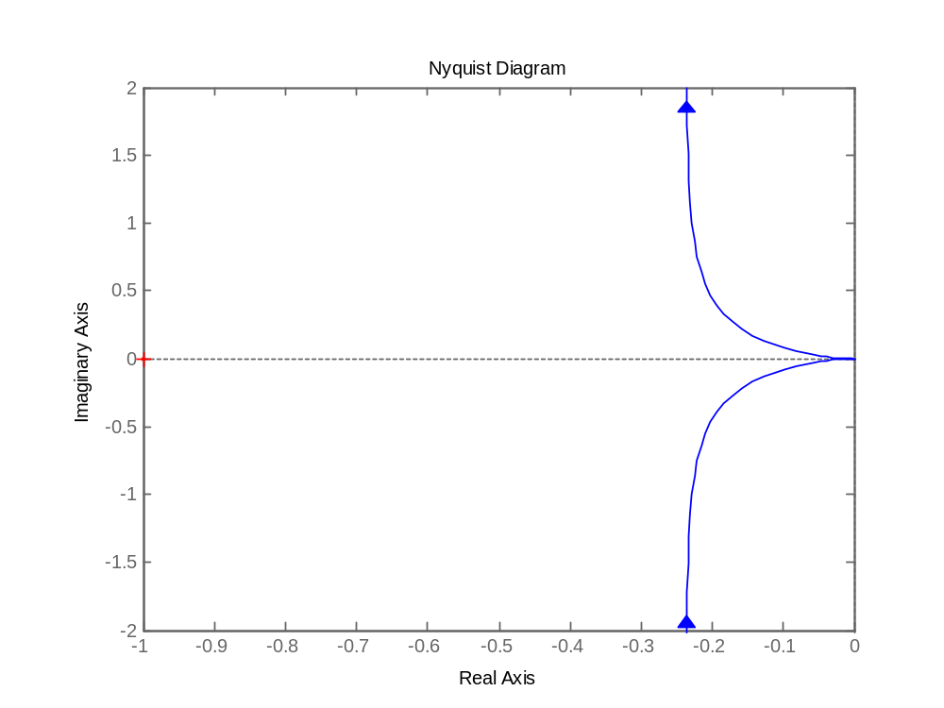


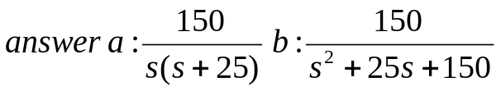
Exercises
2 The polar plot of an open loop system with negative unit feedback is shown.
a) Find the open loop transfer function.
b) Find the closed loop transfer function.
Notes:
<<<3.6>>>
###State Space Models###

Slide 26
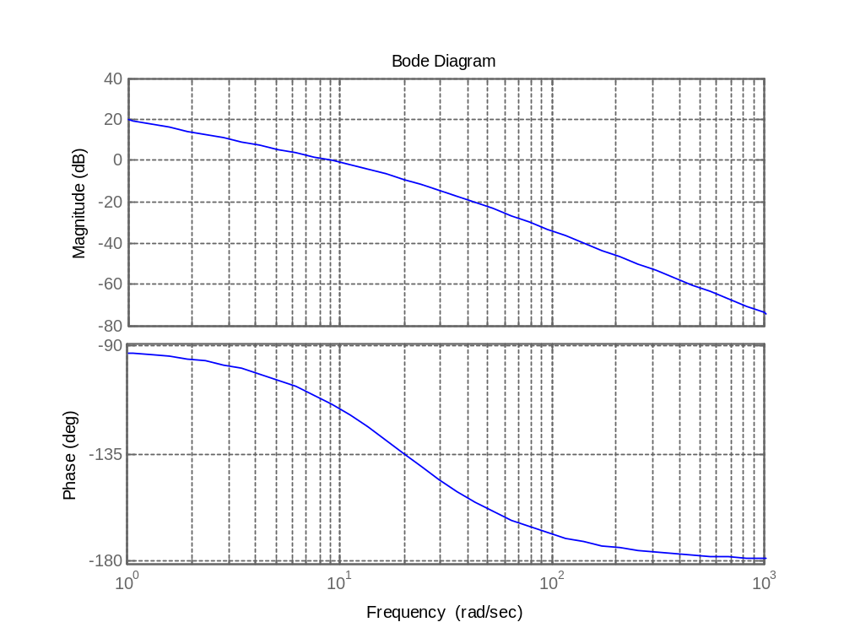
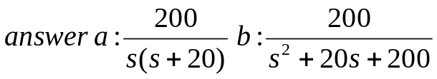
Exercises
3 The Bode plot of an open loop system with negative unit feedback is shown.
a) Find the open loop transfer function.
b) Find the closed loop transfer function.
Notes:
<<<3.6>>>
###State Space Models###

